Slide 1

Feeling safe

Slide 2
Do you FEEL SAFE?
•Everyone has the right to be safe and feel safe in and out of college.
Please tell us if you don’t feel safe. You may feel comfortable:
•Emailing the Feelsafe team at learnerfeelsafeteam@cavc.ac.uk
•Phoning 029 20250420
•Speaking to a Wellbeing Officer at one of our Hubs
•Telling your tutor
•Speaking to a parent or trusted adult who can contact us
It is your safeguarding responsibility to report if you are concerned that someone is in danger of immediate risk.

Slide 3


‘Respect’

Slide 4



Activity 1
What does ‘Respect’ mean?

Slide 5
What does ‘Disrespect’ mean?

Slide 6
Activity 2 ~ What does Respect ....
Look like ?
Sound like ?
Feel like ?

Slide 7
Activity 3
Why is it important to behave respectfully?

Slide 8
Activity 4
What kind of behaviour is disrespectful?

Slide 9
Activity 5
Why do we treat people with respect?

Slide 10
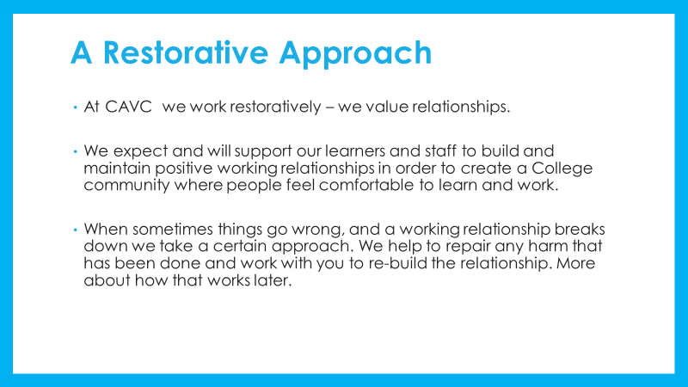

Slide 11
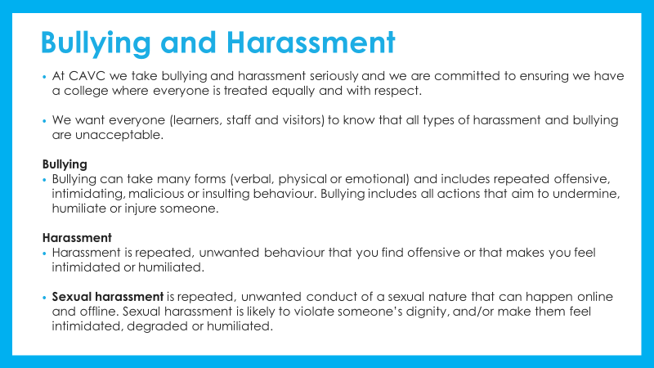

Slide 12
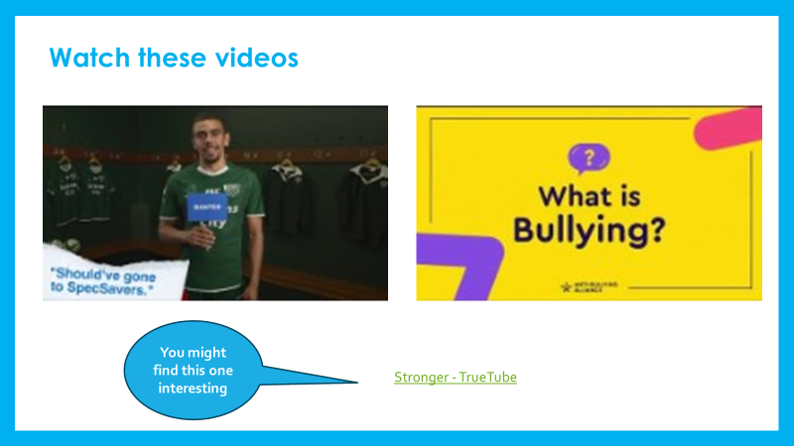

Slide 13
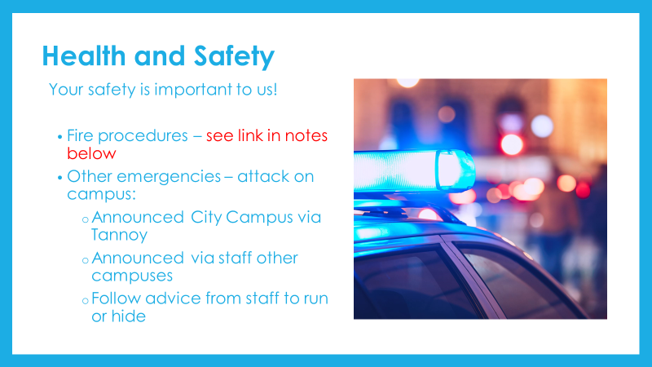

Slide 14


Slide 15


Slide 16
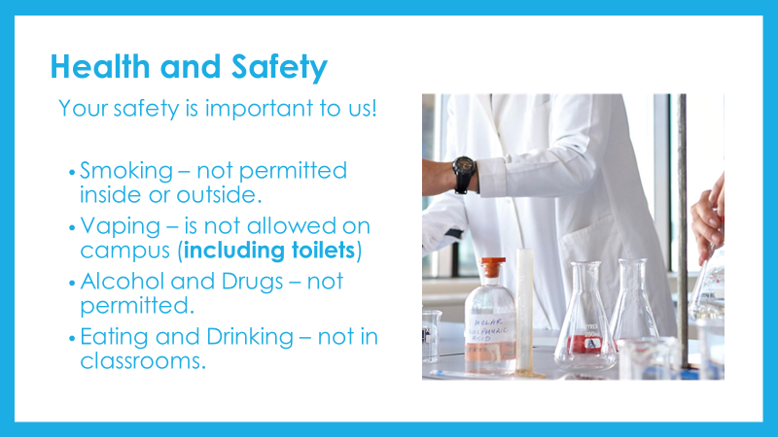

Slide 17


Slide 18
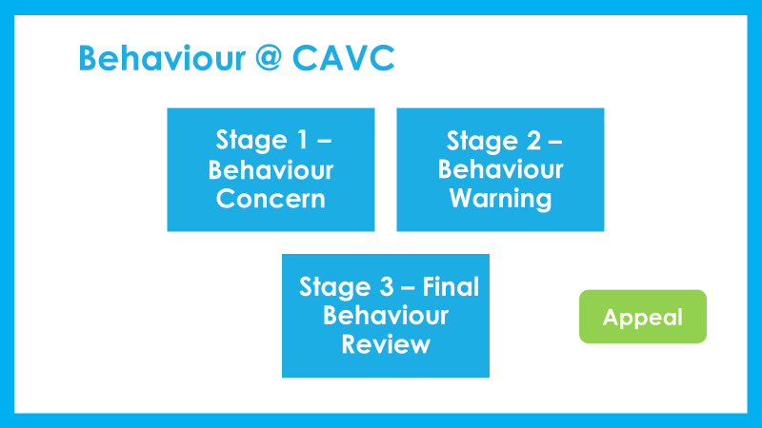

Slide 19
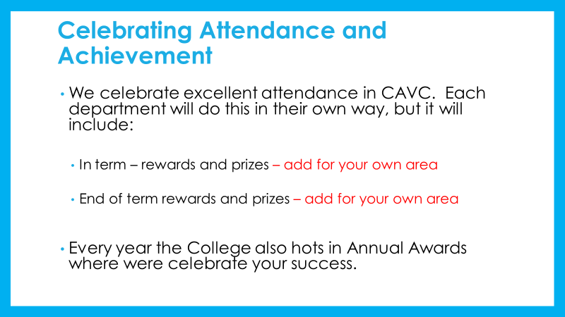

Slide 20


Slide 21


